Slide 1
Neural Network and hardware design
LSI Design Contest 2018

Slide 2
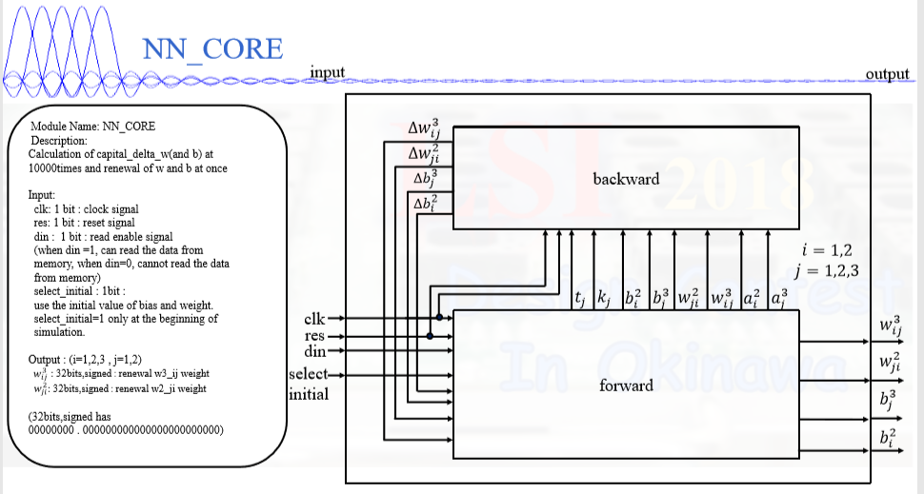

Slide 3
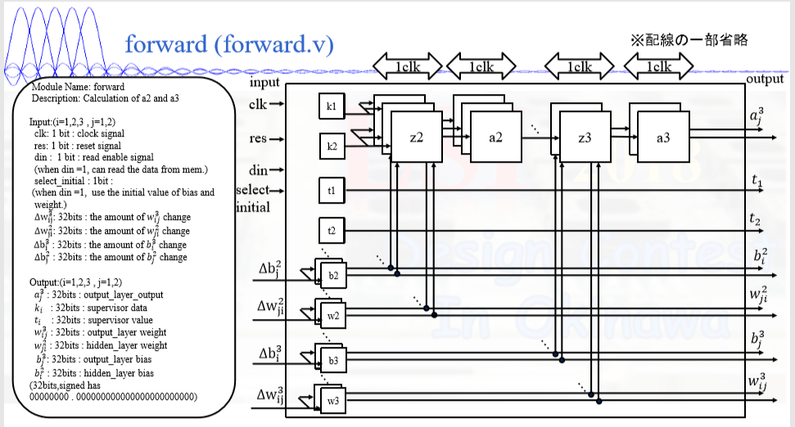

Slide 4
k,t:
-- Description : 4 bits memory to store value of k,t
-- Input:
-- clk : 1 bit
-- din : 1 bit : read enable
-- addr : 4 bits : count number of clock with input from 0 to 15
-- Output:
-- k,t : 32 bits : output value for k,t

Slide 5
w: weight(new) = weight(old) + ∆weight
Description:
Calculation of wi, when the select initial signal is actived, the output will the initial value of wi, and when the select update signal is actived, the output will be the new value of wi
Input:
dw_i : 32 bits signed --delta weight
clk : 1 bit
areset : 1 bit --high active
select_initial : 1 bit --high active
select_update : 1 bit --high active
Output:
wi : 32 bits signed --weight

Slide 6
b: bias(new) = bias(old) + ∆bias
Description:
Calculation of bi, when the select initial signal is actived, the output will the initial value of bi, and when the select update signal is actived, the output will be the new value of bi
Input:
db_i : 32 bits signed --delta bias
clk : 1 bit
areset : 1 bit --high active
select_initial : 1 bit --high active
select_update : 1 bit --high active
Output:
bi : 32 bits signed --bias

Slide 7


z2:
-- Input:
ki : 32 bits signed : input data (i=1,2)
b2 : 32 bits signed : bias value
w2_i : 32 bits signed : weight value(i=1,2)
clk : 1 bit
areset : 1 bit : high active
-- Output:
z2 : 8 bits: output value
z3:
--Input:
a2_i : 32 bits : : input data (i=1,2,3)
b3 : 32 bits : signed : bias value
w3_i : 32 bits: signed : weight value (i=1,2,3)
clk : 1 bit
areset : 1 bit : high active
Output:
z3 : 8 bits 0000.0000 : output value

Slide 8


a2,a3: sigmoid function
-- Description : 8 bits memory to store value of sigmoid calculation.
-- Input:
clk : 1 bit
din : 1 bit : read enable
addr : 8 bits : count number of clock with input from 0 to 255
-- Output:
dout : 32 bits : output value for sigmoid func.

